Slide 1

Urban Development and Sustainability: Exploring Housing, Urbanization, and City Planning
DASC 5433 – BIG DATA
Presented by
Mohammed Zain Badal
Naga Nikhitha Kondamuri
Pratyusha Gadasanthala
Praneetha Bhattu

Slide 2
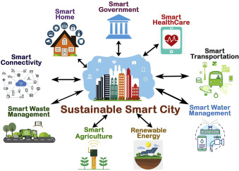
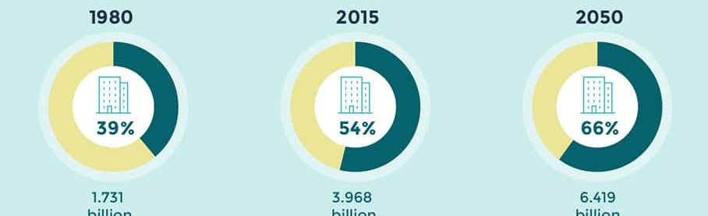
Introduction
Global Population
https://www.sciencedirect.com/topics/social-sciences/smart-sustainable-cities

Slide 3
Problem Statement
Urbanization leads to housing challenges, such as affordability and sustainability.
There’s limited understanding of how specific property features (e.g., location, amenities) correlate with urbanization trends.
The goal: Use property data to close this gap and provide actionable insights for city planners.

Slide 4



Objectives
Housing Trends Data Quality Insights
https://www.flaticon.com/free-icon/house_9235250
https://www.flaticon.com/free-icon/data-quality_5134632
https://www.freepik.com/icons/insight

Slide 5

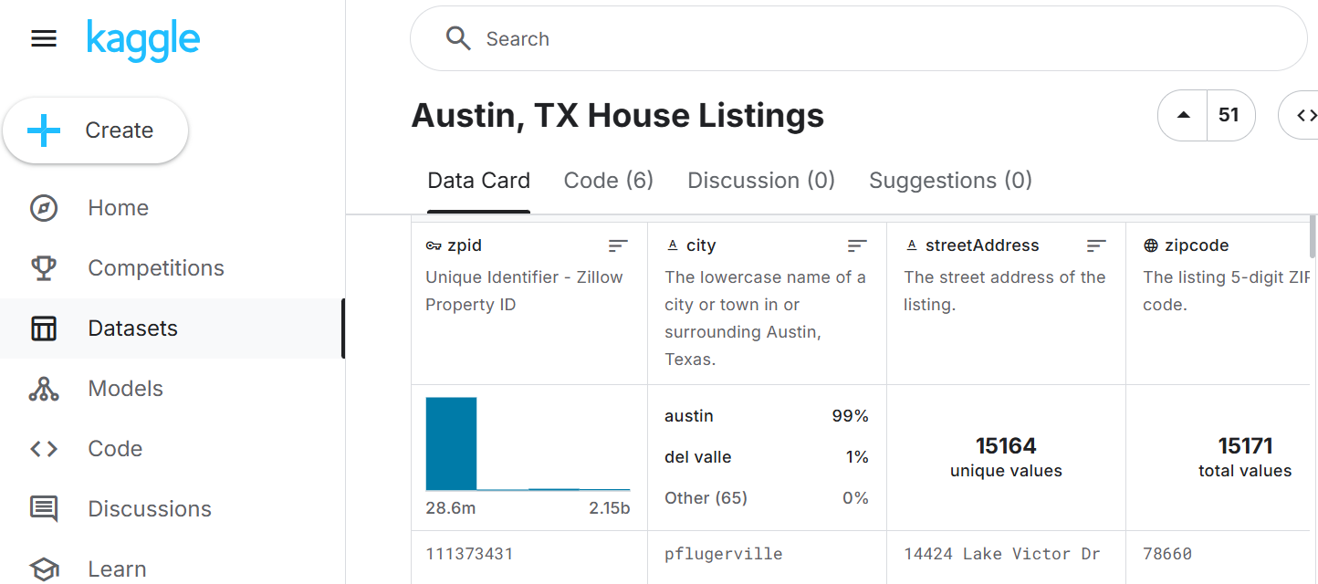
Data Collection and Integration
https://www.kaggle.com/datasets/ericpierce/austinhousingprices?select=austinHousingData.csv
https://imarticus.org/blog/the-hadoop-distributed-file-system-hdfs/

Slide 6
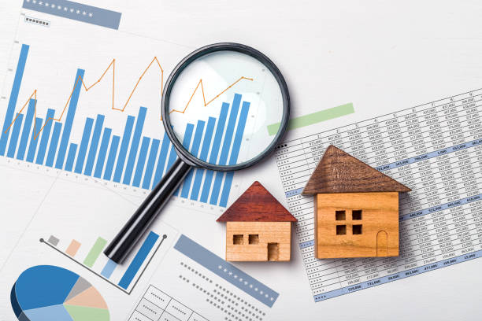
Data Description
Austinhousingdata.csv
Size & Scope:
Original Size: 1.6GB
Number of Rows: 3380684
Number of Attributes: 47
Cleaned data set :
Number of Rows: 3000856
Number of Attributes: 26
https://www.lincolninst.edu/publications/working-papers/persistent-decline-urban-densities
Notes:
.

Slide 7
Key attributes
ID
Location Info
City
Nearby Amenities
Community features
Property Details
Address
Description
Type, etc.
Property Features
Zip-code
Latitude
Longitude
Lot size, etc.
Bedrooms
Bathrooms
Parking
Schools

Slide 8
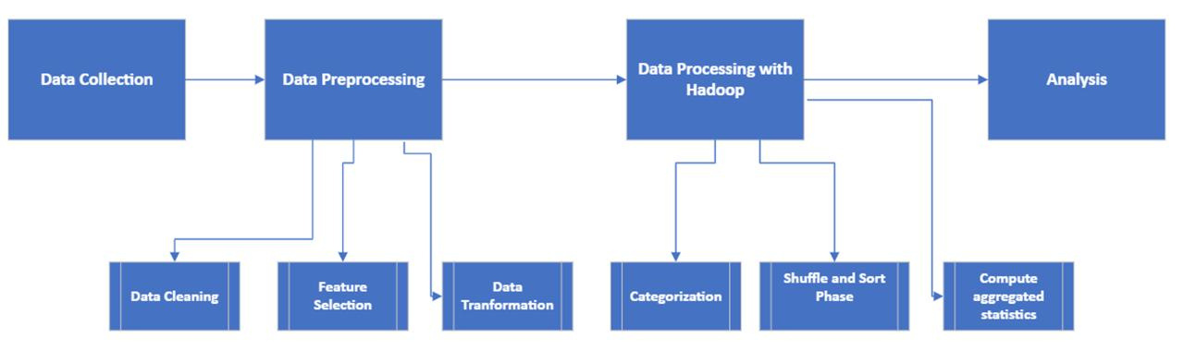
Workflow

Slide 9



Data Preprocessing
Data Standardization and Cleaning
Outlier detection
Feature Engineering
https://iconscout.com/icon/data-format-conversions-1952523_1649537
https://www.flaticon.com/free-icon/engineering_2861721
https://iconscout.com/icon/data-format-conversions-1952523_1649537

Slide 10
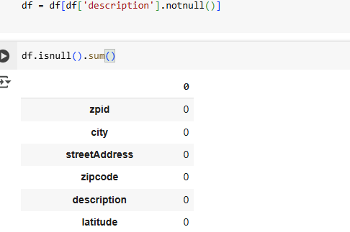
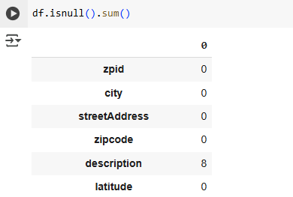
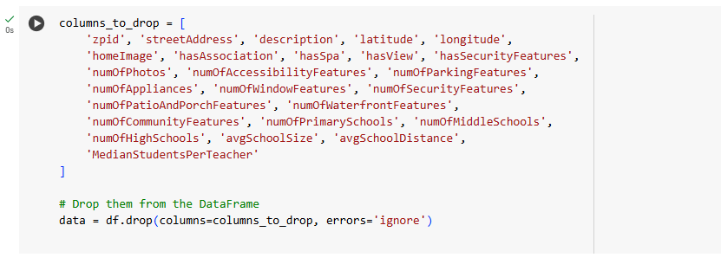
Data Standardization and Cleaning

Slide 11
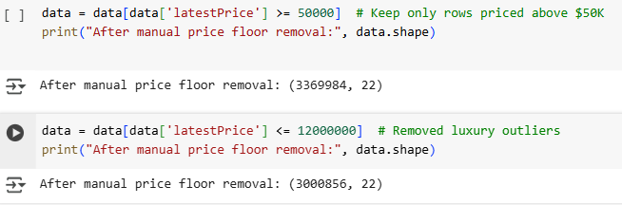
Outlier detection

Slide 12
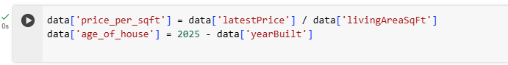
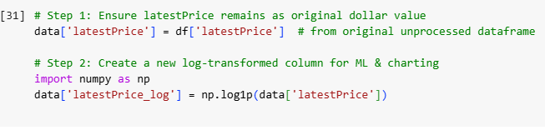
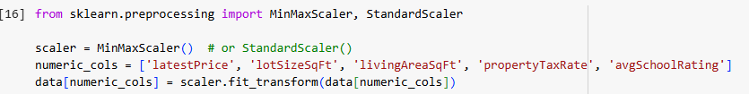
Feature Engineering
Created new features
Applying log transformations on price for scaling
Min Max Scaling

Slide 13
Methodology
Data Collection and Ingestion
MapReduce Processing
Data Analysis & Trend Identification
Data Visualization & Reporting.
Data Preprocessing and Cleaning
Data Partition & Storage

Slide 14

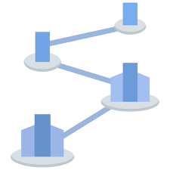

Why Hadoop?
Efficient for Big data
Scalable framework
Parallel Processing
https://www.alamy.com/big-data-icon-simple-element-from-digital-disruption-collection-filled-big-data-icon-for-templates-infographics-and-more-image347920160.html
https://www.flaticon.com/free-icon/scalable_4730219
https://www.freepik.com/icons/parallel-processing

Slide 15
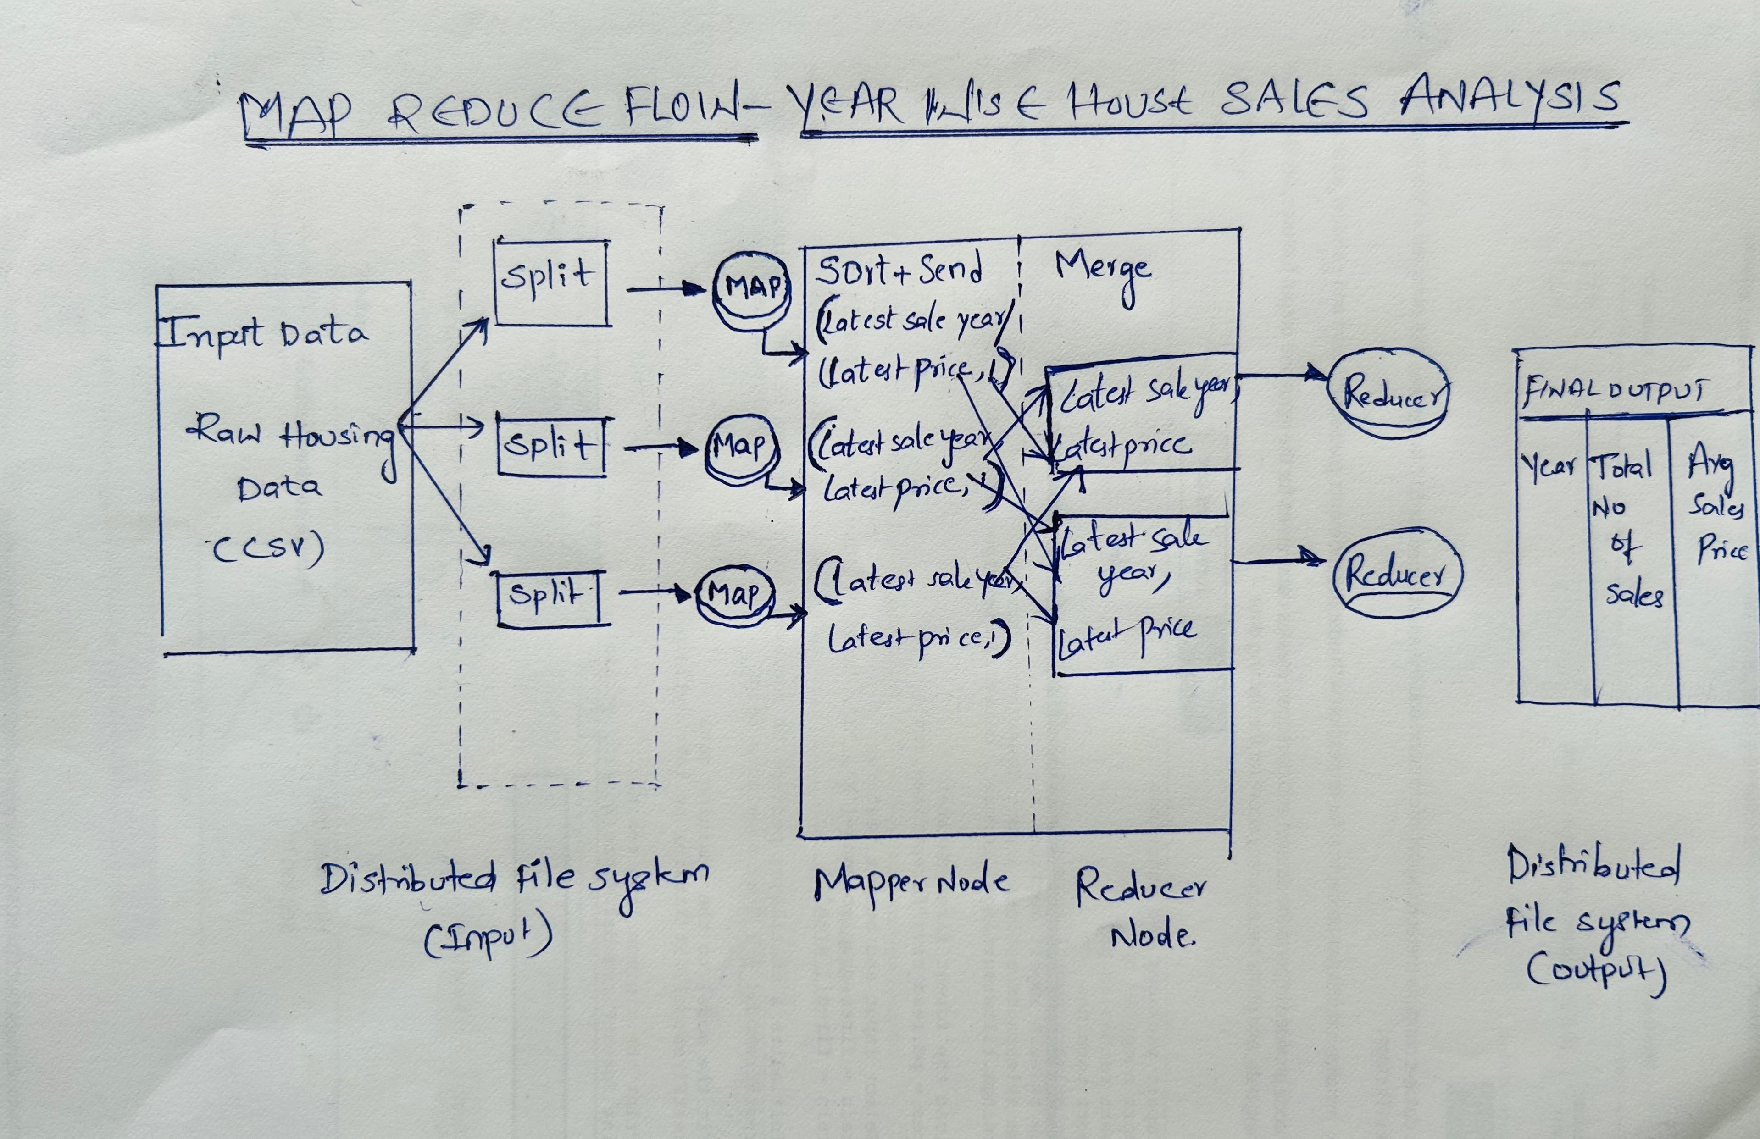
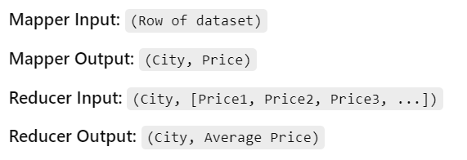
MapReduce Processing

Slide 16

City-Wise Average House Price
Mapper Function:
Input: Processes real estate records
city names –(City)
prices –(latest price)
Output – Key-Value Pairs:
Key: City name –(Eg: Austin)
Value: House Price (latest price ) for aggregation
Reducer Function:
Input: Receives city-wise grouped prices emitted by the mapper
Output: Calculates the average house price for each city.

Slide 17
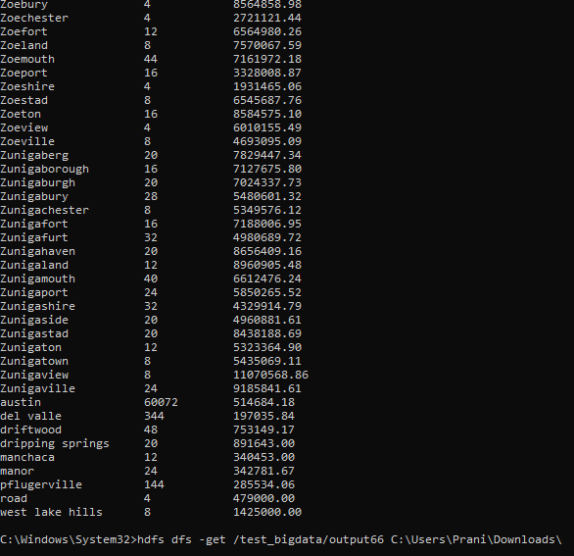
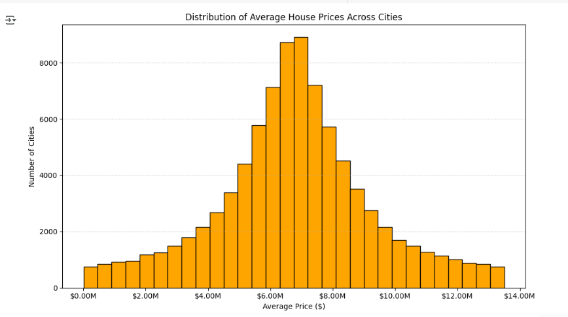
Output for city –latest price

Slide 18
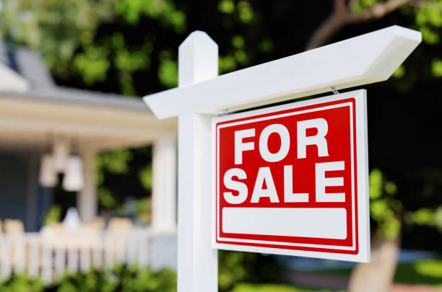
Year-wise House Sales and Average Price
Mapper Function:
Input: Processes real estate records
year of sale – (latest_saleyear)
sale price – (latestPrice)
Output – Key-Value Pairs: Key: Year of Sale – (e.g., 2020) Value: House Price (latest_Price) for aggregation
Reducer Function:
Input: Receives year-wise grouped house prices emitted by the mapper
Output: Calculates the total number of houses sold and the average house price for each year

Slide 19
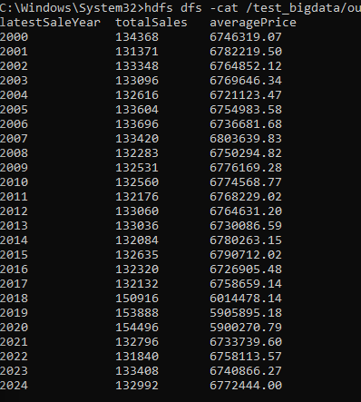
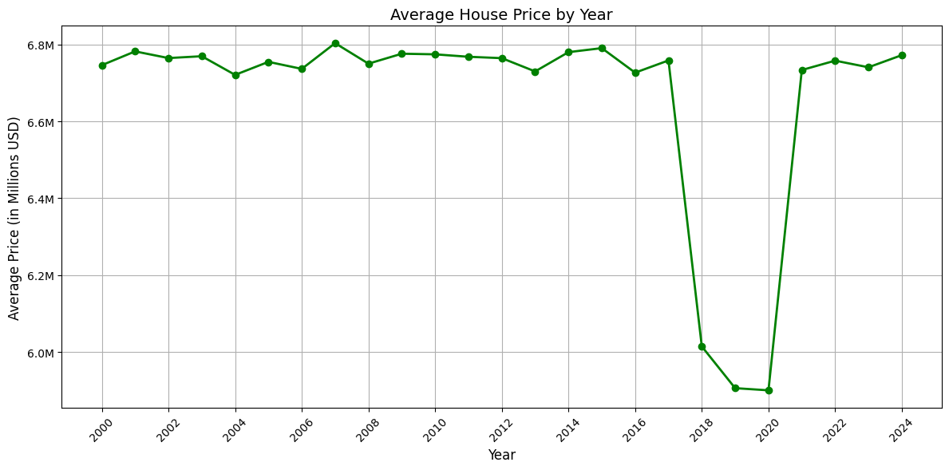
Output for year -wise sales

Slide 20
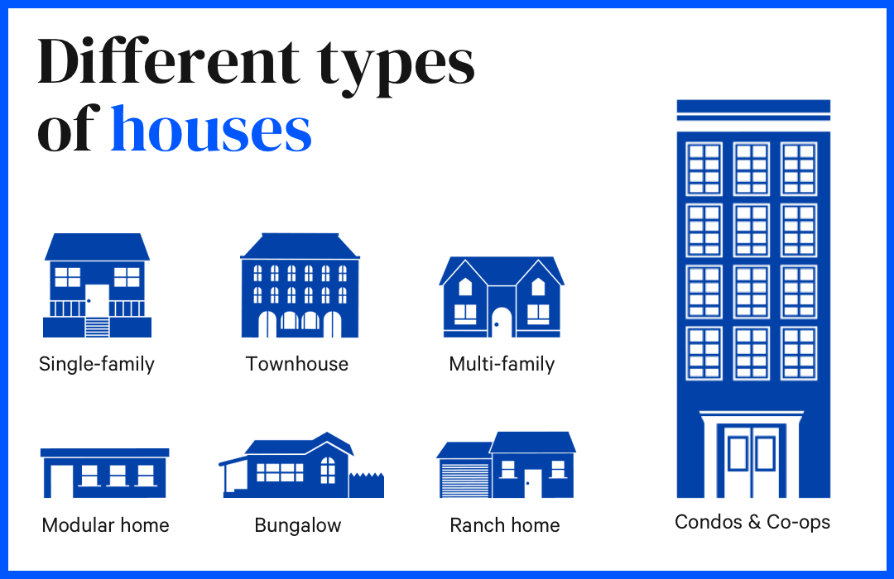
Home Type- Average House Price
Mapper Function
Input: Processes property records with:
Home Type (e.g., Apartment, Condo, Single Family)
Latest Price (house price in dollars)
Output – Key-Value Pairs:
Key: Home type
Value: House price
Reducer Function
Input: Receives grouped prices and counts by home type.
Output: Calculates the average house price for each home type
https://www.bankrate.com/real-estate/types-of-houses/

Slide 21
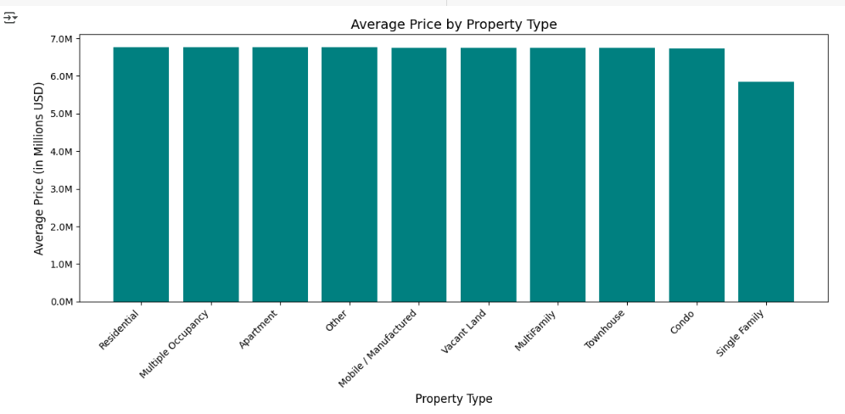
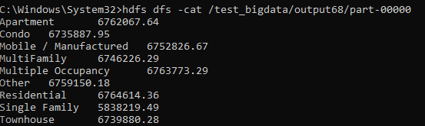
Output for home type

Slide 22
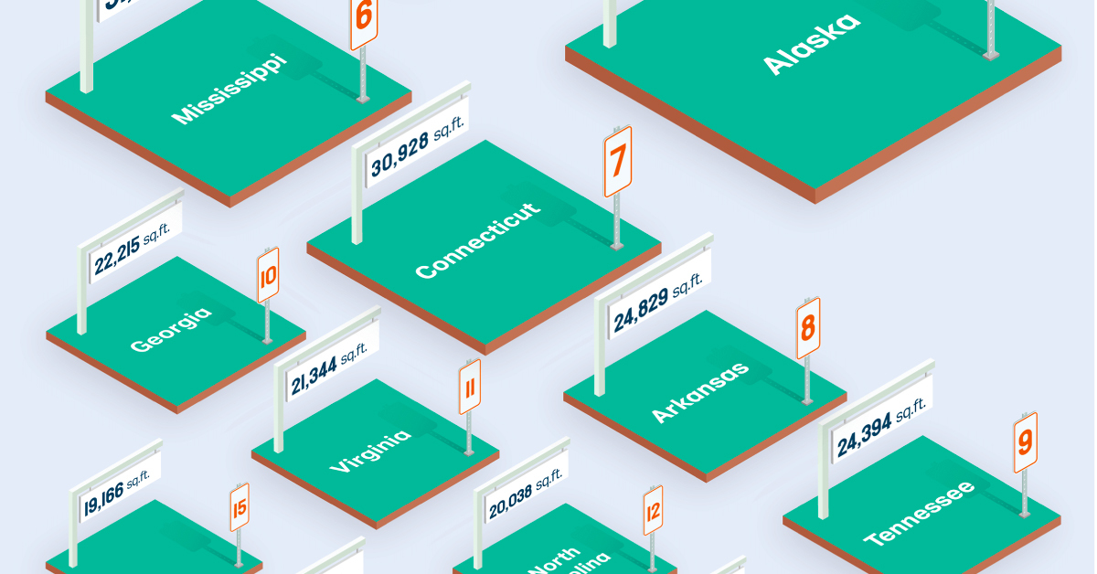
Average Lot Size by Number of Bedrooms
Mapper Function
Input: Processes housing records containing:
Number of Bedrooms (number of bedrooms)
Lot Size Sq Ft (lot size in square feet)
Output – Key-Value Pairs:
Key: Number of bedrooms (e.g., 2, 3, 4, etc.)
Value: Lot size in square feet
Reducer Function
Input: Receives grouped lot sizes per bedroom count
Output: Computes the average lot size (in sq ft) for each bedroom category

Slide 23
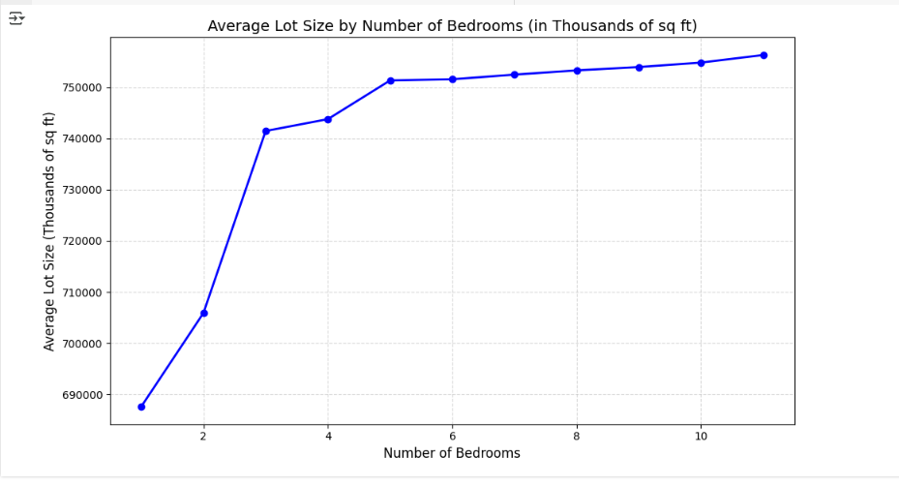
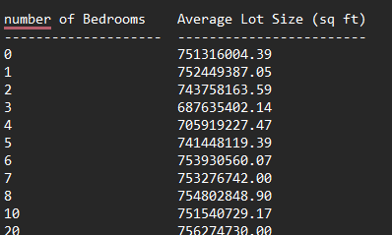
Output for lot size –bedrooms

Slide 24
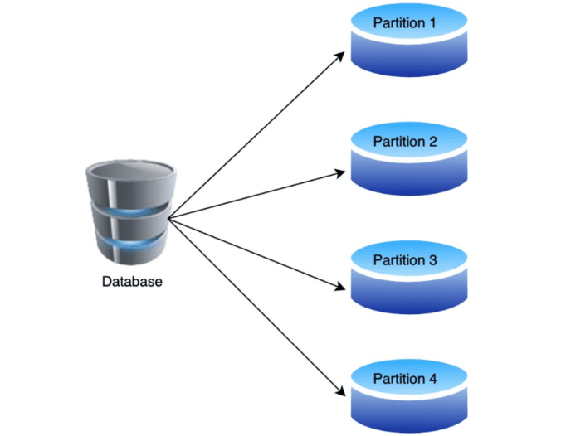
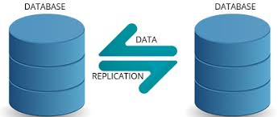
Data Partitioning and Distributed Storage
https://www.supraits.com/infrastructure/managed-cloud/hybrid-cloud-3/data-replication/
https://www.presidio.com/the-importance-of-data-partitioning-strategies-and-considerations/

Slide 25
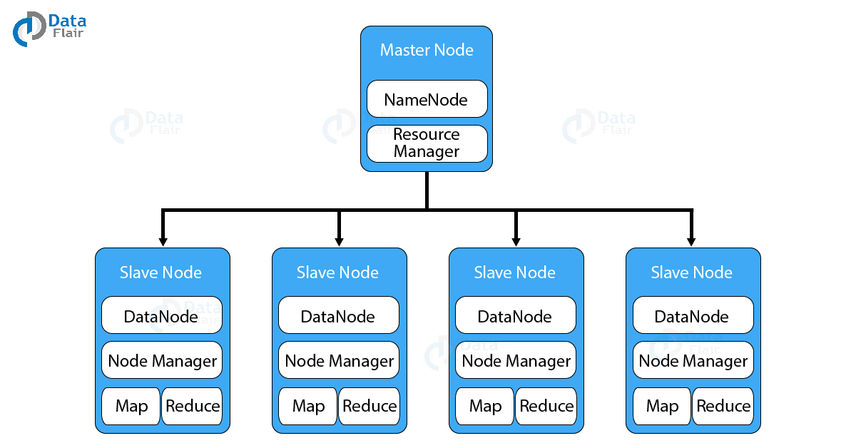
Parallel Processing
https://data-flair.training/blogs/hadoop-architecture/

Slide 26
Parallel Processing Implementing Techniques
Docker Vitrual box
Using physical cluster of machines
Single Machine Multi-Instance Setup

Slide 27
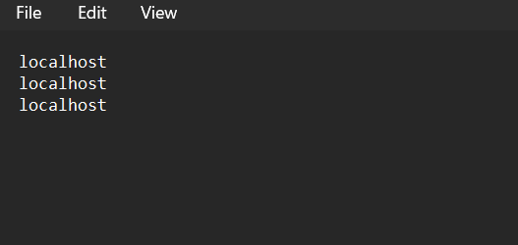
How?
3 separate configuration files for data nodes and name nodes

Slide 28
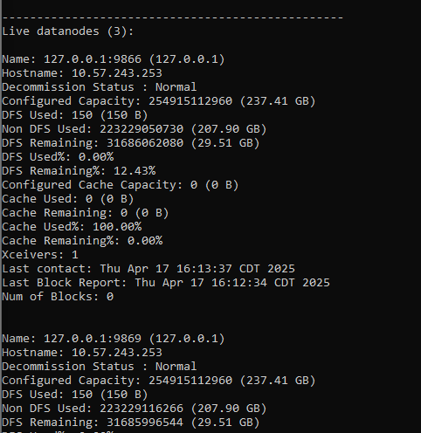
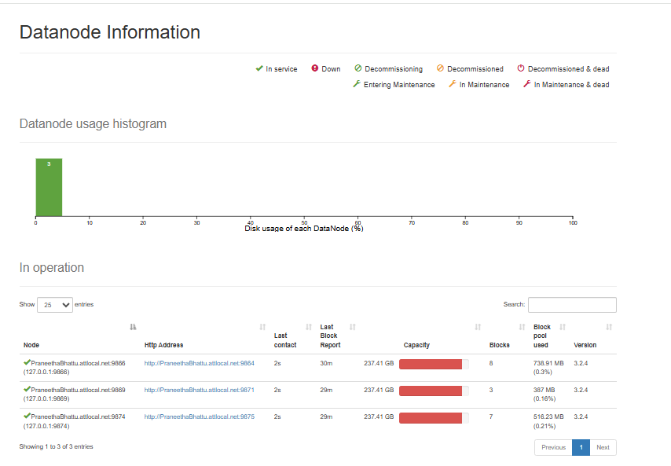
Live data nodes 3

Slide 29
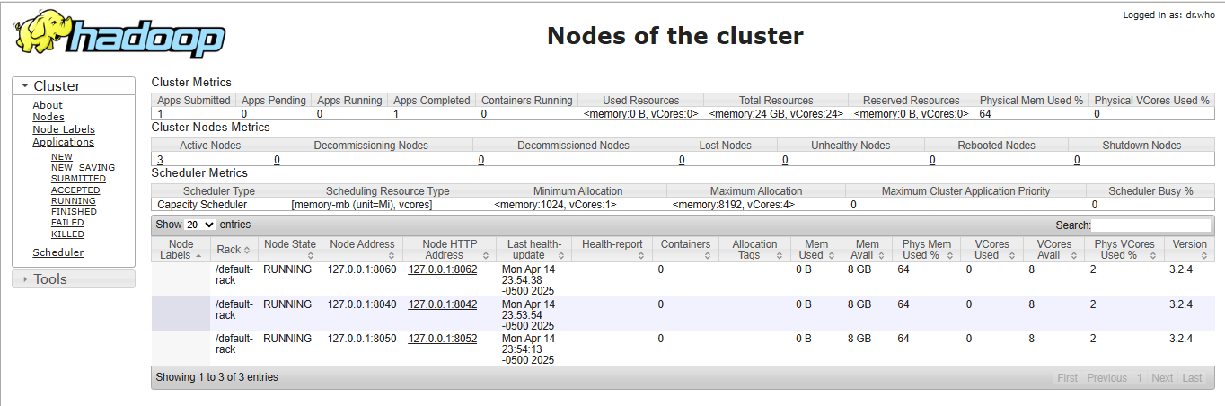
3 Active nodes

Slide 30
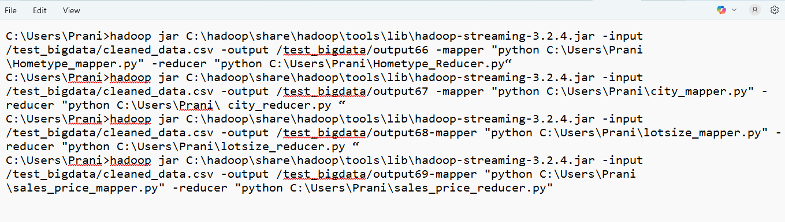
Streaming command

Slide 31
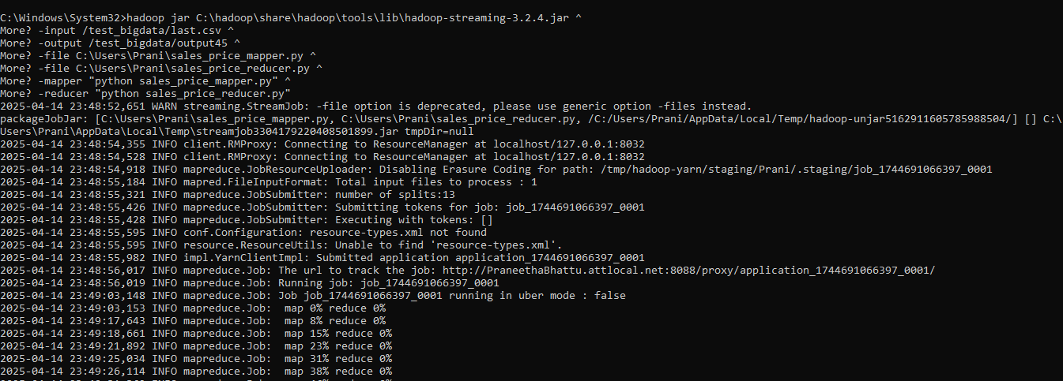
Map reduce Functioning

Slide 32
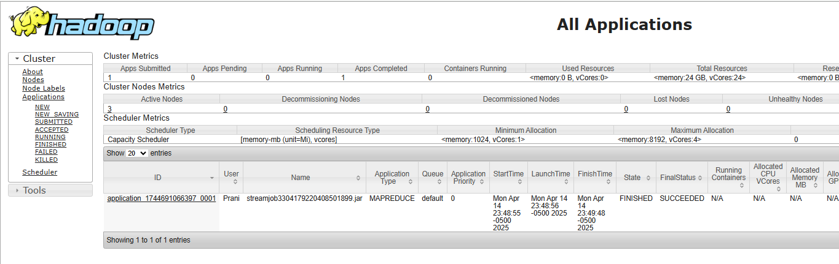
Success of map reduce function
.

Slide 33
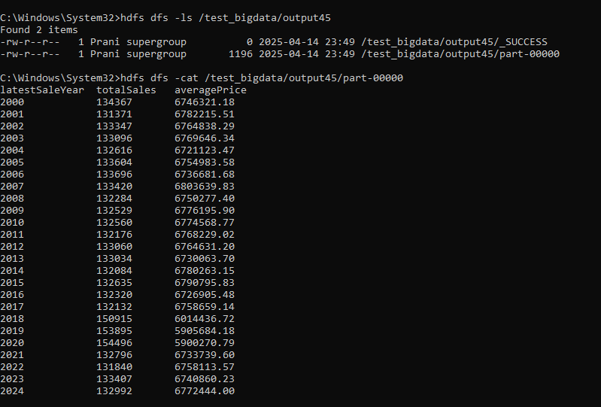
Output example

Slide 34
References
Pierce, E. (2021, April 12). Austin, TX House listings. Kaggle. https://www.kaggle.com/datasets/ericpierce/austinhousingprices
NBER. (n.d.). https://www.nber.org/system/files/working_papers/w23833/w23833.pdf
CSUSB. (n.d.-a). https://scholarworks.lib.csusb.edu/cgi/viewcontent.cgi?article=2750&context=etd-project&httpsredir=1&referer=
World Cities Report 2020: The value of sustainable urbanization. UN. (n.d.). https://unhabitat.org/world-cities-report-2020-the-value-of-sustainable-urbanization
The persistent decline in urban densities. Lincoln Institute of Land Policy. (2024, April 13). https://www.lincolninst.edu/publications/working-papers/persistent-decline-urban-densities

Slide 35

Thank You!
ANY QUESTIONS
https://www.fastweb.com/student-news/articles/do-you-have-any-questions-for-me-what-to-ask-your-interviewer

